Slide 1
The big team science movement in psychology
Wagge et al., 2019, Collabra; Forscher et al. (R+R)
Notes:
Today we will be talking a little bit about the Big Team Science movement in psychology. I think that many of the people that got involved in big team science did so almost unwittingly and we saw a new movement emerge that I think has the potential to solve various complicated problems that we are currently encountering in psychology. However, the big team science movement is not without challenges and we need to reflect carefully on how to use this instrument, so as to avoid mega-mistakes or to pour resources into research that shouldn’t be invested.

Slide 2
The big team science movement in psychology
History behind the big team science movement (Hans)
History behind the big team science movement and the emergence of the Psychological Science Accelerator (Hans)
Wagge et al., 2019, Collabra; Forscher et al. (R+R)
Notes:
In order to start a discussion around the topic for this meeting, I will give some of the history behind big team science in psychology and will talk about how the psychological science accelerator started.

Slide 3
The big team science movement in psychology
History behind the big team science movement (Hans)
History behind the big team science movement and the emergence of the Psychological Science Accelerator (Hans)
Presentation of the Psychological Science Accelerator and development of theory via big team science (Nicholas)
Wagge et al., 2019, Collabra; Forscher et al. (R+R)
Notes:
Nicholas will then talk more in depth about the psychological science accelerator, some of its projects, and how big team science can further psychological theory.

Slide 4
The big team science movement in psychology
History behind the big team science movement (Hans)
History behind the big team science movement and the emergence of the Psychological Science Accelerator (Hans)
Presentation of the Psychological Science Accelerator and development of theory via big team science (Nicholas)
How can big team science translate theory into applications to improve life’s conditions (Julianne)
Wagge et al., 2019, Collabra; Forscher et al. (R+R)
Notes:
Julianne will then discuss how big team science can make psychology useful. I think this is a separate, yet important step and you will also see there is still lots to discuss here how to make this connection, but this forum I see as a good opportunity to start that discussion. Nicholas will then also make an important point about the complexity of psychological theories via the concept of the multiverse, which I believe is an important point when we consider translating psychological theories into applications.

Slide 5
History behind the big team science movement
Bem, 2011; Levelt et al., 2012; Simmons et al., 2011
Notes:
So, let’s get to it. In 2011 – kind of a special year if you were in psychology then - I think a couple of things dramatically changed for many psychologists. I will start with some points that I presume are somewhat common knowledge, but I want to ensure that we have the same starting points.
In 2011, Daryl Bem published a paper that suggested that people could foresee the future, using established experimental methods at the time. Either that meant that everything we know about physics is wrong, or there is something deeply wrong with the way we do business.

Slide 6
History behind the big team science movement
Bem, 2011; Levelt et al., 2012; Simmons et al., 2011
Notes:
I think we are pretty certain that it is the latter. The same year, an article appeared by Joe Simmons et al., where they showed that if they used data-contingent analyses, they could demonstrate that people become two years younger. In the same paper, they showed that by using data contingent analyses, false positive ratios could go up to nearly as much as 80%, basically allowing you to show whatever you wanted.

Slide 7
History behind the big team science movement
Bem, 2011; Levelt et al., 2012; Simmons et al., 2011
Notes:
Also the same year, which I don’t put into the same category, but which was a motivation for me to get involved was the Stapel case. And I think for many scientists, the trust that they had in doing science evaporated, because Diederik Stapel, a now former professor of social psychology, was found to and admitted that he had engaged in mass data fabrication.

Slide 8
History behind the big team science movement
Notes:
What one could then see is the emergence of many small replication studies, where the evidential value of the findings, at least to me (and, admittedly, in hindsight), was as unclear as many original findings.
A first response to these types of small scale replications was to conduct replications at many sites at the same time, such that the status of the evidential value of the replications became much clearer right away.
While many cite the replication effort by the Open Science Collaboration as an exciting one that shows replicability concerns in psychological science, to me a much more exciting initiative was the manylabs replication effort, where the same finding was conducted in many different sites.

Slide 9
History behind the big team science movement
Notes:
Since then, many of such efforts have been undertaken, and manylabs became a model for other initiatives. For instance, perspectives on psychological science started a new section on registered replication reports, which is exclusively dedicated to multisite studies.

Slide 10
History behind the big team science movement
Notes:
Around the same time as the manylabs projects were initiated and largely inspired by the writings of Mike Frank, Rebecca Saxe, and Jon Grahe, we started the Collaborative Replication and Education project, which is an initiative to integrate replication into undergradate research methods courses. Via this initiative, students engage in learning about research methods, while conducting replications with a very high level of quality control.

Slide 11
Challenges facing psychological science
History behind the big team science movement (Hans)
Challenges to generalizability
Henrich et al., 2010; Nuijten et al., 2016; Silberzahn et al., 2018
Notes:
But these problems were not the only ones the discipline were facing.
We knew for some years that psychology had been facing challenges to generalizability (i.e., our theories are either not investigated in other countries, they originate mostly from the US, and/or they poorly generalize to other countries)

Slide 12
Challenges facing psychological science
History behind the big team science movement (Hans)
Challenges to generalizability
Challenges to computational reproducibility
Henrich et al., 2010; Nuijten et al., 2016; Silberzahn et al., 2018
Notes:
We know that we are facing challenges to computational reproducibility (i.e., the fact that if other people repeat the same analyses, they don’t find the same results),

Slide 13
Challenges facing psychological science
History behind the big team science movement (Hans)
Challenges to generalizability
Challenges to computational reproducibility
Challenges to inferential reproducibility
Henrich et al., 2010; Nuijten et al., 2016; Silberzahn et al., 2018
Notes:
And more recently we know of challenges to inferential reproducibility (that is, one can reasonably make many different analytical decisions when asking questions about a dataset and these can result in very different conclusions about the same dataset, even when confronted with relatively simple questions).

Slide 14
History behind the big team science movement
Chartier, 2017
Notes:
These are all quite complicated challenges that simply cannot be solved by one individual researcher alone.
To confront these challenges, Chris Chartier in 2017 wrote a blog post about building a cern for psychological science. Chris wondered and was quite jealous about the accuracy with which astronomers could predict, to a second, when the moon would cross the path of the sun, a very, very complicated problem. Thinking about this event he thought that there should be an equivalent in psychology, where he first thought about setting up a study with ~10 labs and 1000 participants, but he eventually envisioned a network with thousands of labs, and millions of participants (even this first study was already amongst more than 10,000 participants).
The crucial part in his vision however was the idea of a standing network instead of ad hoc networks like the manylabs studies, and he wanted to create a network that is open to criticism, is transparent, reinvents itself all the time, and which has democratically elected leaders.

Slide 15
History behind the big team science movement
Chartier, 2017
Notes:
Now, to be honest, I think that even Chris did not imagine the complexity of some of the problems we were confronted with and that we have found out throughout the years.
This already became apparent in the first study the PSA adopted, led by Ben Jones and Lisa DeBruine, where many of these challenges (concerning computational and inferential reproducibility, as well as generalizability, started emerging). In addition, throughout the years, it just became painfully visible how many policies need to be created to conduct these studies successfully, how much labor such work cost, and – despite all the positives that I have to say about the PSA -> throwing in my personal opinion here – how conservative our field can be and how US-focused in our theories we are. I think working with the PSA brings these problems even more to the fore.
This is where I can give the word to Nicholas, who will be saying more about what the Psychological Science Accelerator is.

Slide 16
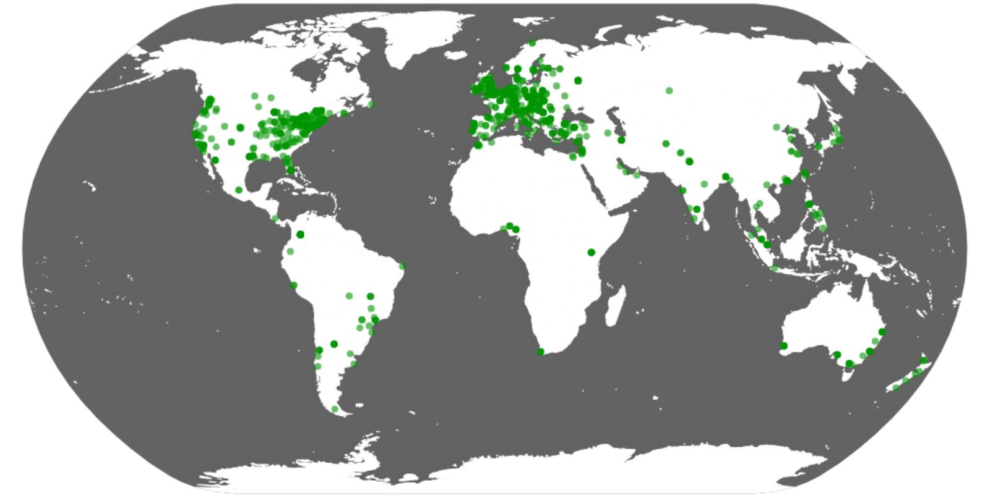
Psychological Science Accelerator: A globally-distributed network of researchers that pool intellectual and material resources to accelerate the discovery of generalizability knowledge in psychological science.
Notes:
The Psychological Science Accelerator is a globally-distributed network of researchers that pool intellectual and material resources to accelerate the discovery of generalizability knowledge in psychological science.
We are a grassroots academic organization with little funding and a loosely distributed organizational structure. Anybody can join our network free of charge, so long as they are willing to contribute. As of today, our network contains 1254 researchers from 82 countries. And we’ve thus far been responsible for some of the largest studies ever completed in social and cognitive psychology.

Slide 17
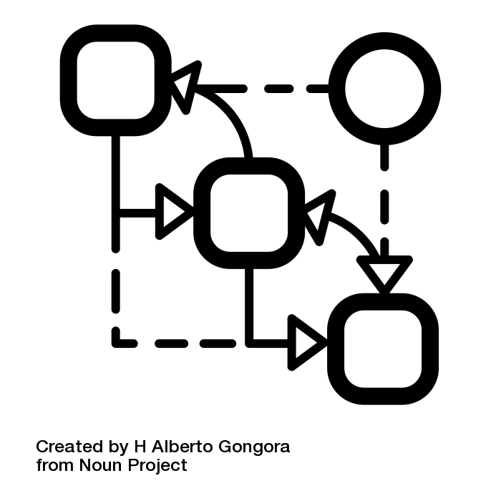


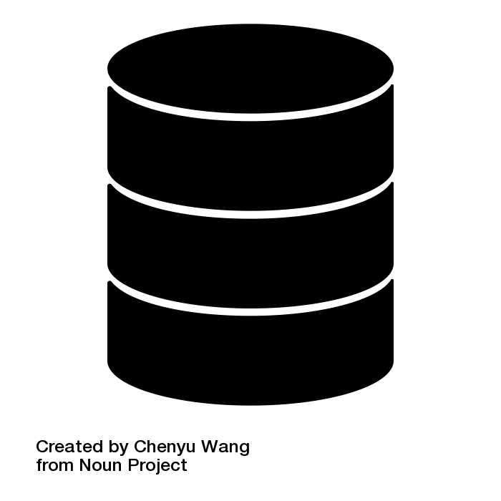
Types of activities
Theory-oriented data collection
Jones, B. C., DeBruine... & Coles, N. A. (2021). To which world regions does the valence–dominance model of social perception apply? Nature Human Behaviour.
Application-oriented data collection
Wang, K., Goldenberg, A… & Moshontz, H. (2021). A multi-country test of brief reappraisal interventions on emotions during the COVID-19 pandemic. Nature Human Behaviour.
Methods-oriented projects
Luong, R., McAuliffe, W. H. B… & Li, Y. (submitted). Structural validity evidence for the Oxford Utilitarianism Scale across 14 languages. Psychological Test Adaptation and Development.
Dataset-development projects
Buchanan, E. M., Maxwell. N. P… & Coles, N. (in-prep). SPAML: Semantic priming across many languages.
Notes:
Our network has a variety of streams of activity.
[] Most of work have traditionally been focused on theory-oriented data collection efforts. For example, our first study examined the extent to which an influential valence-dominance model of social perception replicated across world regions. The project involved 243 collaborators who collected data from 11,570 participants spanning 41 countries. And we found some evidence that the valence-dominance model does not fully capture the structure of social perception judgments in many areas of the world.
[] Some of our work focuses on application-oriented data collection efforts. For example, we recently published a multi-country test of a brief cognitive reappraisal intervention on emotions during the COVID-19 pandemic. The project involved over 500 collaborators who collected data form 21,644 participants spanning 87 countries. And we found evidence that this intervention consistently decreased negative emotion and increased positive emotions across world regions.
[] Some of our projects are more methods-oriented. We are currently working on a project that will provide comprehensive assessments of the psychometric properties of the popular Oxford Utilitarianism Scale in 14 languages.
[] And last, some of work is primarily geared towards developing datasets that enable others to answer interesting questions about psychology. For example, we are currently working on developing a cross-linguistic dataset of semantic priming values that we believe will help researchers uncover the cognitive underpinnings of the structure and organization of the mental lexicon

Slide 18
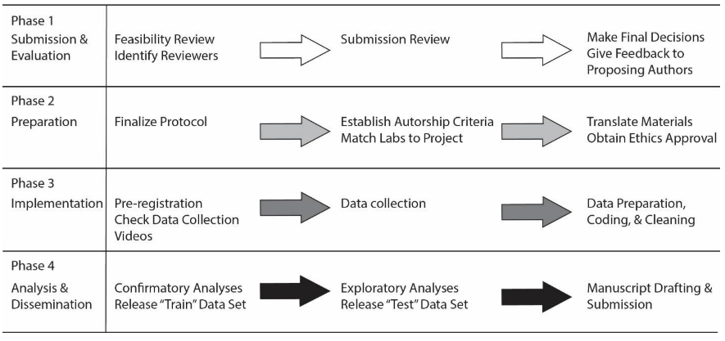
Typical workflow
Moshontz et al. (2018). AMPPS
Notes:
Given how diverse our research portfolio is, there is not necessarily a single workflow. But, to give you an idea, this is how our network typically operated.
[] First, we generally allow anybody to submit proposals for research studies. These proposals are generally structured like a Stage 1 Registered Report, meaning that the researchers write the Introduction and Methods section with the intentions of adding the Results and Discussion after data are collected.
These proposals are reviewed internally by a Study Selection Committee that is tasked with evaluating intellectual merit and feasibility. The committee then decides whether to accept, request revisions, or reject proposals. [] Next, proposing authors finalize their protocol and recruit collaborators within the network. The typical collaborator helps with data collection, but many proposing authors also recruit collaborators to help with project management, data management, translation, the coordination of ethics approval across multiple sites, data management, and data analysis. [] Generally, projects are accepted as registered reports, but if not, proposing authors upload a pre-registration plan. They work with labs to ensure that everyone has the correct data collection procedures in place. And then the data are collected.
[] Afterwards, the data are analyzed, the manuscripts are drafted, collaborators go back and forth, and eventually the work is published.

Slide 19
Remarks from Julianne

Slide 20


Addressing the “multiverse problem” via the Psychological Science Accelerator
Nicholas A. Coles
Stanford University | Psychological Science Accelerator
Notes:
PSA was born out of the replication crisis. But, as it has grown up, our scope has widened quite substantially. And useful way to conceptualize the scope of our activity is to borrow the idea of the “science multiverse”.

Slide 21
“In the quantum multiverse, every choice, every decision you've ever and never made exists in an unimaginably vast ensemble of parallel universes.”
Payne (2012). Constellations
Notes:
For those who are familiar with the idea, in sci-fi writing the multiverse often refers to the idea that many of the choices and decisions we make have an impact on the future. And that you can imagine that differences in how we make those choices can lead to a large amount of potential parallel or alternative universe.
I’m not qualififed to argue about there truly is a multiverse. Nonetheless, I think this idea provides a useful metaphor for thinking about how psychologists face a variety of choices and decisions that can lead us to very different scientific conclusions.

Slide 22
Notes:
As an example, let’s imagine a typical study in psychology. Not all studies will work like this, of course, so just consider it as an example.

Slide 23
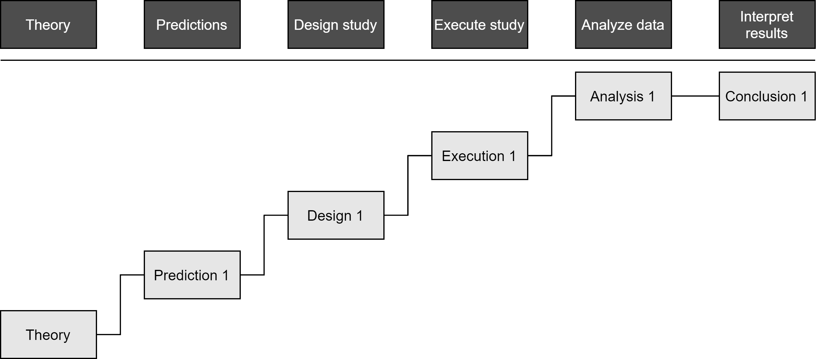
Notes:
Let’s say we are interested in testing a psychological theory.
Based on this theory, we might derive some sort of hypothesis about how the world works.
To test this hypothesis, we then design a study.
We then execute the study.
Once the study is done, we process and analyze her data.
And then form some sort of conclusion.

Slide 24
Notes:
This is the standard way that people are taught to do research in psychology. But we know that, in practice, it’s not this simple.

Slide 25
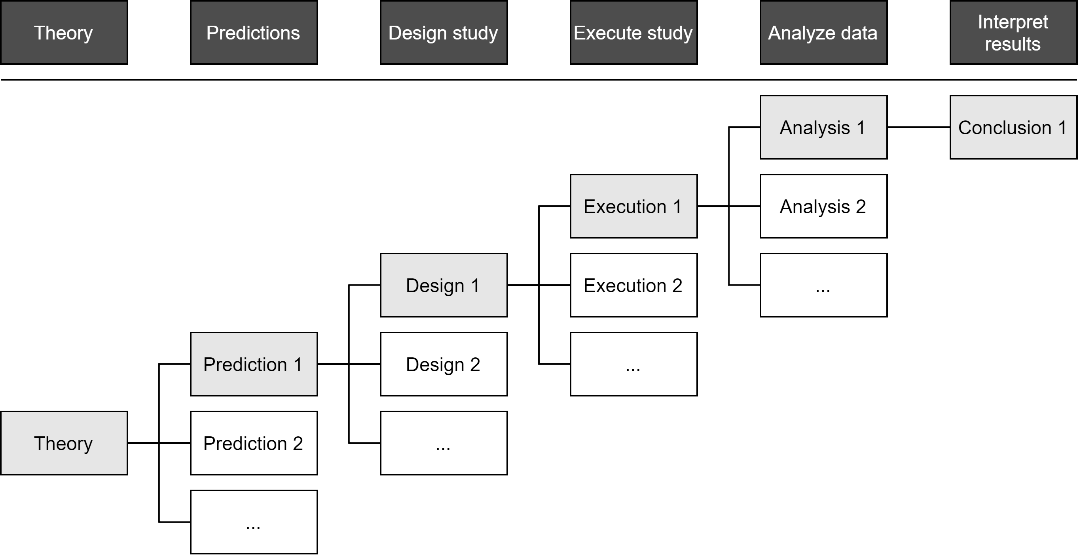

Notes:
We know that there are many predictions she could have derived to test her theory-of-interest.
And for each one of those predictions, there are many studies she could have designed as tests.
And for each one of those designs, there are many different ways that she could have actually executed the study.
And for each one of those study executions, there are many different ways that she could have modeled and analyzed her data.

Slide 26
Given the same research question, researchers will design different studies. These different studies can lead to different (and sometimes conflicting) results.
Landy et al. (2020). Psychological Bulletin
Running the same study in different labs leads to variability in effect sizes that often exceed what we expect from chance alone.
Klein et al. (2018); AMPPS
Given the same research question and dataset, researchers will process and analyze data differently. These different approaches can lead to different (and sometimes conflicting) results.
Silberzahn et al., 2018; Nature
Notes:
Beyond our own experiences with these decision, we have systematic evidence that choices we make matter. Matter in such a way that we cannot put too much stock in the findings from any one study.

Slide 27
Notes:
This idea of a multiverse means that our traditional way of doing research doesn’t provide a comprehensive assessment of the theories and questions we seek to test.
And the desire to conduct more comprehensive tests is something that inspired a lot of work in the Psychological Science Accelerator.

Slide 28
The effects of framing COVID-19 health messaging in terms of losses vs. gains
Dorison, Lerner… Coles. R&R; Affective Science
Notes:
Here’s an example from a recent study we completing on COVID-19 message framing.

Slide 29
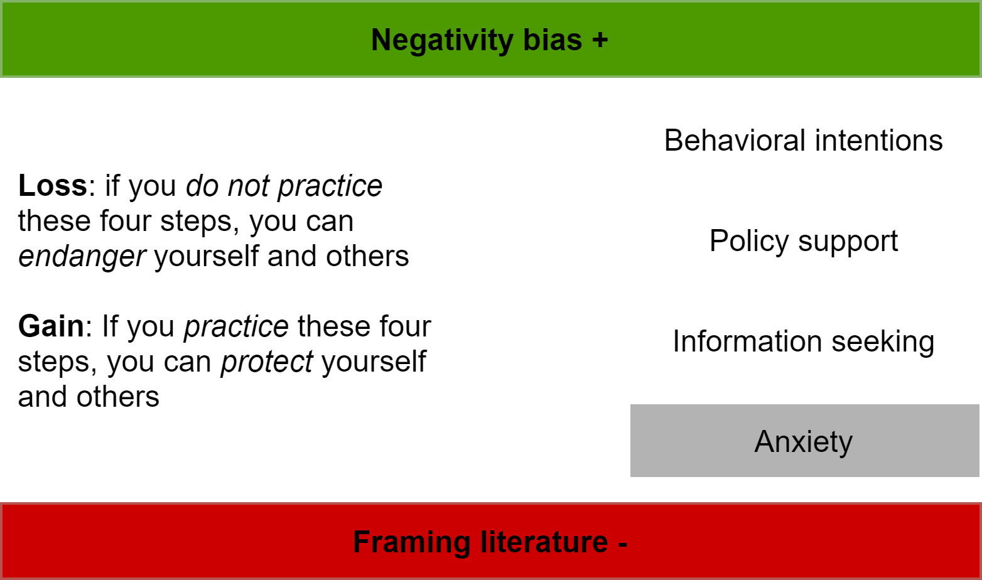
The effects of framing COVID-19 health messaging in terms of losses vs. gains
Dorison, Lerner… Coles. R&R; Affective Science
Notes:
[] In this study, some participants were exposed to so-called “loss-framed” health messages that emphasized the negative consequences of nonadherence to health recommendations. [] Other participants were exposed to so-called “gain-framed” messages that emphasized the positive consequences of adherence to health recommendations

Slide 30
The effects of framing COVID-19 health messaging in terms of losses vs. gains
Dorison, Lerner… Coles. R&R; Affective Science
Notes:
In a global study, we examined the effects of this message framing on
Intentions to engage in protective behaviors
Support for public policies designed to protect against COVID-19
And propensity to seek additional information about COVID-19

Slide 31
The effects of framing COVID-19 health messaging in terms of losses vs. gains
Dorison, Lerner… Coles. R&R; Affective Science
Notes:
In addition to its implications for the communication of health information, this study allowed us to test competing hypotheses about the effect of message framing on these outcomes.

Slide 32
The effects of framing COVID-19 health messaging in terms of losses vs. gains
Dorison, Lerner… Coles. R&R; Affective Science
Notes:
According to negativity bias research, loss framing should increase these three outcomes.

Slide 33
The effects of framing COVID-19 health messaging in terms of losses vs. gains
Dorison, Lerner… Coles. R&R; Affective Science
Notes:
But according to the health messaging framing literature, loss framing should decrease these outcomes.

Slide 34
The effects of framing COVID-19 health messaging in terms of losses vs. gains
Dorison, Lerner… Coles. R&R; Affective Science
Notes:
Last, as a secondary outcome, we also measured self-reported anxiety—which I will review at the end.

Slide 35
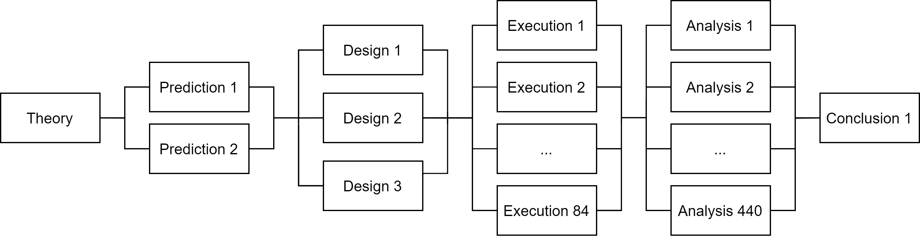
The effects of framing COVID-19 health messaging in terms of losses vs. gains
Dorison, Lerner… Coles. R&R; Affective Science
Notes:
To conceptualize this study in a multiverse framework, we started with two competing predictions

Slide 36
The effects of framing COVID-19 health messaging in terms of losses vs. gains
Dorison, Lerner… Coles. R&R; Affective Science
Notes:
To test these competing predictions, we used three different variants of a message framing manipulation—which we combined into a single large study design.

Slide 37
The effects of framing COVID-19 health messaging in terms of losses vs. gains
Dorison, Lerner… Coles. R&R; Affective Science
Notes:
We executed the study across 84 countries

Slide 38
The effects of framing COVID-19 health messaging in terms of losses vs. gains
Dorison, Lerner… Coles. R&R; Affective Science
Notes:
And then analyzed the data 440 different ways.

Slide 39
Notes:
Here is a summary of what we found.

Slide 40
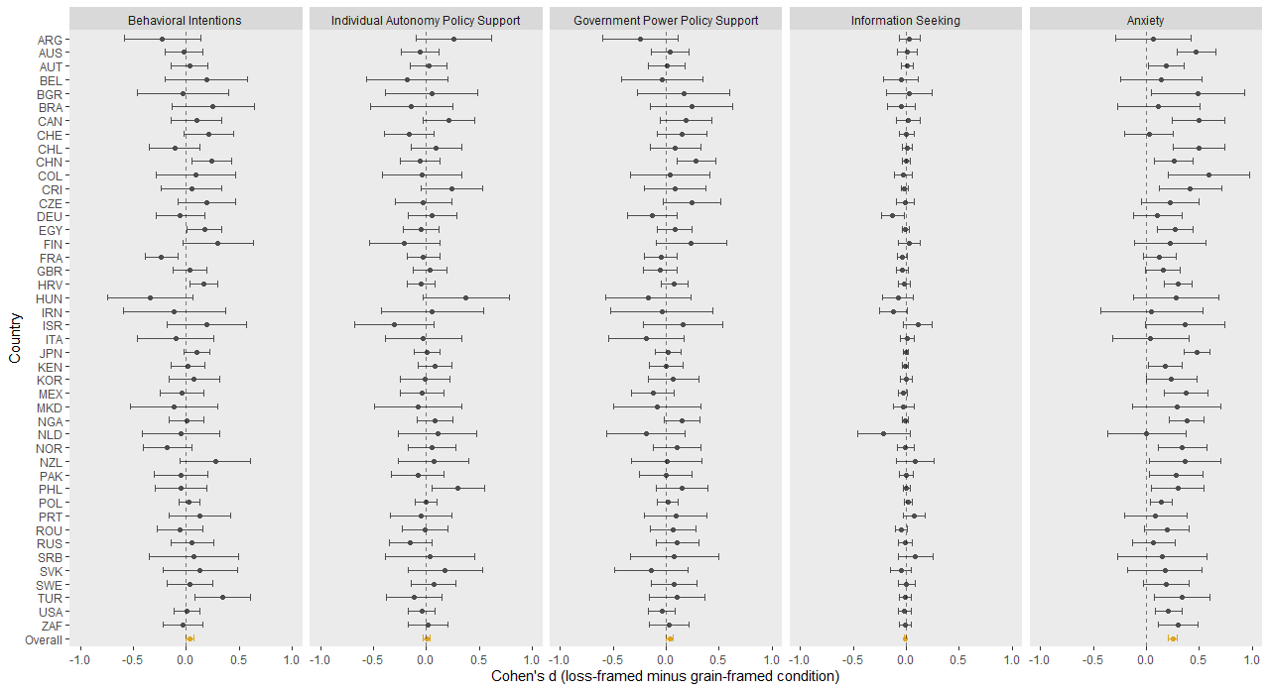
Notes:
Contrary to predictions derived from the negativity bias and health messaging literatures, we did not find that message framing impacted behavioral intensions to engage in COVID-19 protective behaviors.
[orient to graph]
X-axis is effect size index, with positive values indicating that loss framing led to increases in the outcome denoted in the top panel. The y-axis ticks denote country-specific effect size estimates, which I will review later.
Dotted line is no effect. Yellow point is the overall effect size estimate and confidence interval

Slide 41
Notes:
Also contrary to predictions derived from the negativity bias and health messaging literatures, we did not find that message framing impacted support for two different types of COVID-19-related public policies

Slide 42
Notes:
Last, we did not observe that message framing impacted participants’ propensity to seek information about COVID-19

Slide 43
Notes:
We observed almost no evidence of between-country variability in these results. Furthermore, we observed little evidence that the estimated effects varied depending on how the manipulation was specifically worded.

Slide 44
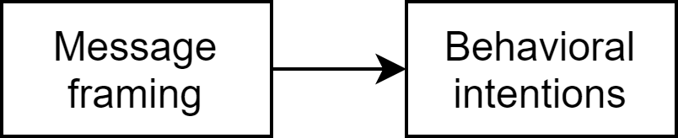
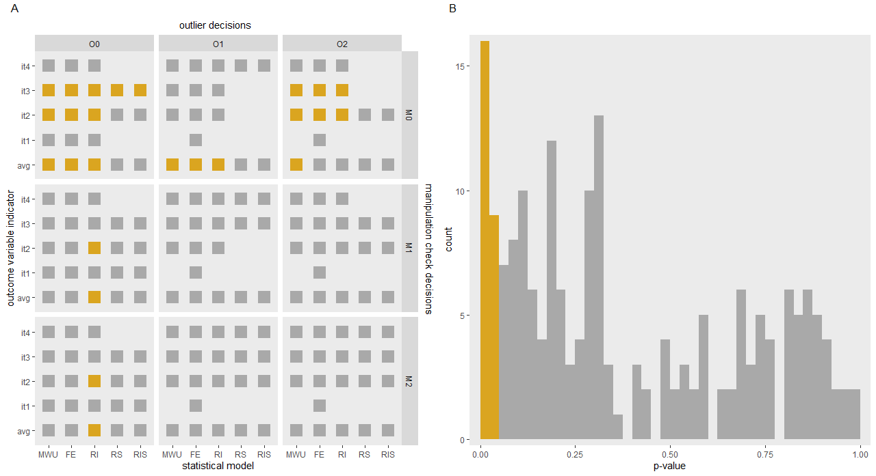
Dorison, Lerner… Coles. R&R; Affective Science
Notes:
We also found that these patterns tended to be quite similar across a variety of data processing and analysis strategies. We had a four-item measure of behavioral intentions [] and separately analyzed not only the average of those items, but also the individual items.

Slide 45
Dorison, Lerner… Coles. R&R; Affective Science
Notes:
We modeled the data using a non-parameteric Mann-Whittney U test, a simple fixed-effect model, a random-intercept model, a random-slop model, and a random-intercpets-and-random-slopes model.

Slide 46
Dorison, Lerner… Coles. R&R; Affective Science
Notes:
We examined three different decision for handling outliers

Slide 47
Dorison, Lerner… Coles. R&R; Affective Science
Notes:
And three different decision regarding how to handle responses to a manipulation check item.
In total, this led to 225 different data analysis strategies

Slide 48
p < .05
p > .05
model convergence issue
Dorison, Lerner… Coles. R&R; Affective Science
Notes:
For simplicity, this figure categorizes the results by the significance of the p-value of the effect estimate. This figure also denotes instances where models failed to converge—failures that also inform us about potential problems with the model assumptions.

Slide 49
p < .05
p > .05
model convergence issue
Dorison, Lerner… Coles. R&R; Affective Science
Notes:
For example, this column denotes the results from fully random models fitted with data from all participants—regardless of whether they were an outlier or passed the manipulation check. For two of the items, the models failed to converge. For one of the items, we found significant evidence of a framing effect. For one of items and the average of all items, we did not find evidence of a significant effect.

Slide 50
p < .05
p > .05
model convergence issue
Most analysis strategies did not yield significant evidence of a message framing effect.
Models that did suggested that the magnitude of the effect was negligible (< 0.03 change on a 7-point behavioral intentions measure)
Dorison, Lerner… Coles. R&R; Affective Science
Notes:
When we examined all the data analysis strategies, we did not generally find reliable evidence of a message framing effect.
When models did yield significant evidence of an effect, the size of this effect was negligible.
So, we concluded that the COVID-19 message framing manipulation had little-to-no effect on intentions to engage in COVID-19-related protective behaviors.

Slide 51
Notes:
Intriguingly, though, we did find that message framing impacted a secondary outcome: [] anxiety.

Slide 52
Notes:
These effects were very similar across countries

Slide 53
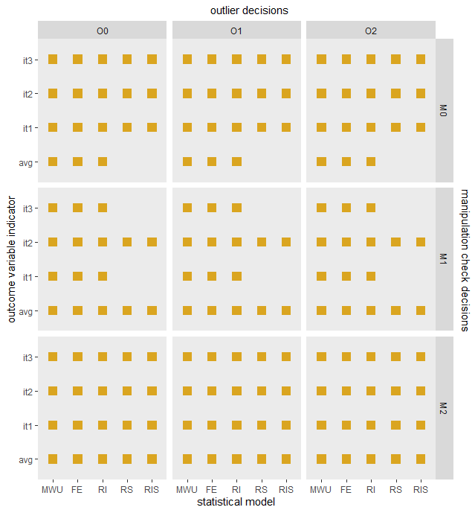
Notes:
And remarkably consistent across data analysis workflows. To summarize the study: we found evidence that a COVID-19 message framing manipulation had little-to-no effect on any of the primary outcomes of interest—but did lead to unintended increases in anxiety.

Slide 54
Addressing the “Multiverse Problem” via Big Team Science
Nicholas A. Coles @coles_nicholas_
Stanford University | Psychological Science Accelerator
Notes:
So this provides a very quick example of how the idea of a science multivere encourages us to design studies that more comprehensively test the questions we are interested in.
To summarize, this idea of a multiverse reminds us to be humble. Humble about the fact that every choice and every decision we’ve ever and never made can impact our scientific inferences.
Studying human are complicated.
Complex systems cannot probably be understood by simple studies.
Seemingly small differences in how we operationalize our constructs, design our studies, sample our participants, and analyze our data have impacts on the conclusions we derive from our work.
These generalizability concerns constrain the theories we give to the people in our world, the predictions we make, and the interventions we recommend.
This complexity requires more resources than a single research group can provide. So we are pooling our intellectual and material resources to try to develop a more comprehensive understanding on psychology.

Slide 55
Addressing the “Multiverse Problem” via Big Team Science
Nicholas A. Coles @coles_nicholas_
Stanford University | Psychological Science Accelerator
Notes:
Thank

